Slide 1
Ages & Stages Questionnaire: Social-Emotional
ASQ:SE
April 6, 2015
Claire Woodard
Program Trainer

Slide 2
What the ASQ:SE is:
Research-based social and emotional screening tool
An easy, 10-15 minute face-to-face “interview” with parents
A conversation starting tool that helps staff learn about a child and any parent concerns
Available in both English and Spanish
Able to be copied- you don’t have to use an original questionnaire, but can use a copy

Slide 3
What the ASQ:SE is NOT:
It is NOT something you send home with the parents
It is NOT used to diagnose a child
It is NOT to be completed over the phone

Slide 4
Performance Standard
§ 1304.20 (b) (1):
(b) Screening for developmental, sensory, and behavioral concerns.
(1) In collaboration with each child's parent, and within 45 calendar days of the child's entry into the program, grantee and delegate agencies must perform or obtain linguistically and age appropriate screening procedures to identify concerns regarding a child's developmental, sensory (visual and auditory), behavioral, motor, language, social, cognitive, perceptual, and emotional skills (see 45 CFR 1308.6(b)(3) for additional information). To the greatest extent possible, these screening procedures must be sensitive to the child's cultural background.

Slide 5
When do we use the ASQ:SE?
ASQ-SE (45 day item) Grantee sites ASQ- SE will be completed at time of enrollment for all children

Slide 6
Knowing which form to use
The screening form comes in eight different ages:
6 months
12 months
18 months
24 months
30 months
36 months
48 months
60 months

Slide 7
Knowing which form to use
Use the child’s chronological age in months to determine which form to use. The front page has the age (in months) at which each form should be used.

Slide 8
Chronological Age
To determine age in months, you must first determine age in years:
On a piece of paper, write out the screening date and child’s DOB in the following format:
YEAR | MONTH | DAY
Screening Year | Screening Month | Screening Day
Year Born | Month Born | Day Born

Slide 9
Chronological Age
Subtract the child’s Date of Birth from the Screening Date, starting with the “Day” column (far right):
If Screening Day is smaller than Day Born, you have to “borrow” from the testing month:
1. Subtract 1 month from the Screening Month and then,
2. Add 30 days to the Screening Day. (Always add 30 days, regardless of what month it is.)
3. Continue subtracting Day Born from Screening Day.
YEAR | MONTH | DAY
Screening Year | Screening Month | Screening Day
Year Born | Month Born | Day Born

Slide 10
Calculating Days Example:
Date Tested: October 12, 2012
Date of Birth: December 18, 2008
YEAR | MONTH | DAY
12 | 10 | 12
08 | 12 | 18
-1=9
+30=42
-
=24

Slide 11
Calculating Months:
Next, subtract the Month Born from the Screening Month.
If Screening Month is smaller than Month Born, you have to “borrow” from the Screening Year:
Subtract 1 year from the Screening Year and then,
Add 12 months to the Screening Month.
Continue subtracting Month Born from Screening Month.
YEAR | MONTH | DAY
12 | 10⁻¹⁼⁹ | 12⁺³⁰⁼⁴²
08 | 12 | -18
 |  | =24
-1=11
+12=21
-
= 9

Slide 12
Calculating Years:
Finally, subtract the Year Born from the Screening Year.
This child is 3 years, 9 months, and 24 days old.
YEAR | MONTH | DAY
12 | 10⁻¹⁼⁹ | 12⁺³⁰⁼⁴²
-08 | -12 | -18
 | =9 | =24
-1=11
+12=21
=3

Slide 13
Converting Age in Years to Age in Months:
Ex: This child is 3 years, 9 months, and 24 days old.
Multiply Child’s Age in Years (i.e., 3) by 12
(1 year = 12 months)
Add this number (i.e., 36) to the bottom number in the Month column (i.e., 9).
Child’s Chronological Age in Months is 45.
YEAR | MONTH | DAY
12 | 10⁻¹⁼⁹ | 12⁺³⁰⁼⁴²
-08 | -12 | -18
 | =9 | =24
-1=11
+12=21
=3
x12
=36
+9=45

Slide 14
ASQ:SE Forms
Use the Child’s Chronological Age in Months to determine which form to use.
If Child’s Chronological Age in Months is: | Use this Form:
3- 8 months | 6 month form
9-14 months | 12 month form
15-20 months | 18 month form
21-26 months | 24 month form
27-32 months | 30 month form
33-41 months | 36 month form
42-53 months | 48 month form
54-65 months | 60 month form
Notes:
Which form would we use for each of the examples?

Slide 15
ASQ:SE Forms
The ranges for when to use each form can be found at the top of the ASQ:SE information page (p. 2)

Slide 16
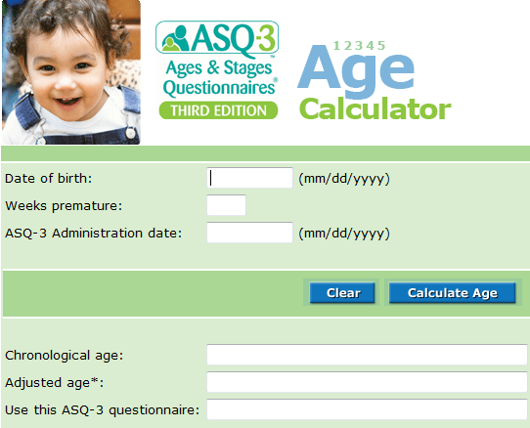
Chronological Ages
http://agesandstages.com/age-calculator/
“Weeks premature” will be 0 because we usually don’t know if the child was born premature.

Slide 17
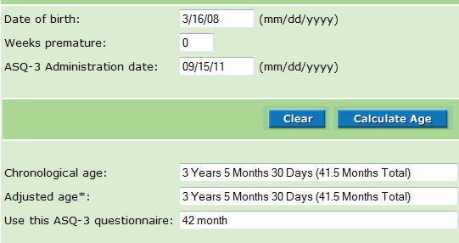
Chronological Age
http://agesandstages.com/age-calculator/
1
2
5
The number before the decimal (.) is the age in months. The number after the decimal is not needed to determine which form to use.
3
4
The information in the “ASQ-3 questionnaire” box is for a different screening and does not apply to the ASQ:SE. You will need to use the number of months found in the “Chronological age” box and compare it to the months each ASQ:SE form can be used.

Slide 18
ASQ:SE Administration
Must be completed with the legal guardian (not the babysitter, grandma, etc.)
Sit face-to-face with the parent or guardian while you ask the questions. Do not just send home with parents!!
If not done face to face, the parent may not understand all questions and may not answer correctly
Doing the questionnaire with the parent will give you more insight into family dynamics and how to help the family- You may even be able to set some goals for your FPAs because of the conversation!

Slide 19
ASQ:SE Administration
Fill in all of the blanks on page 2:
Child’s name
Child’s Date of Birth
Today’s Date- date questionnaire completed with parent
Person filling out this questionnaire- Name of parent/guardian you are talking to
What is your relationship to the child- Relationship of person listed above to child (i.e., mother, father, etc.)
Your telephone- parent’s phone number
Your mailing address- center/site address
City- city where center/site is located
State- Texas
Zip code- center/site zip code
List people assisting in questionnaire completion- Name of Head Start staff interviewing parent (YOU)
Administering program or provider- center/site name
Do not leave any blanks on this page.

Slide 20
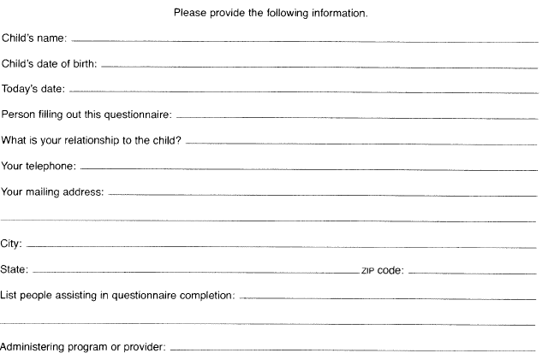
ASQ:SE- Page 2 Example
Jon Smith
01/19/09
09/15/12
Maria Smith
mother
806-555-7777
1946 Ave Q
Lubbock
Texas
79411
Suzy Bell
Fields Building Head Start

Slide 21
ASQ:SE Administration
Go through all questions with the parent/guardian.
Do not skip any questions
Mark the appropriate boxes based on the parent’s response (“Most of the Time”, “Sometimes”, or “Rarely or Never”).

Slide 22
ASQ:SE Administration
Any question receiving 10 points (x) could be a red flag.
Ask parent if 10 point questions are a concern.
If parent says no, write “No Concern” next to the question
If parent says yes, mark the “Concern” bubble
No concern
√
√
√

Slide 23
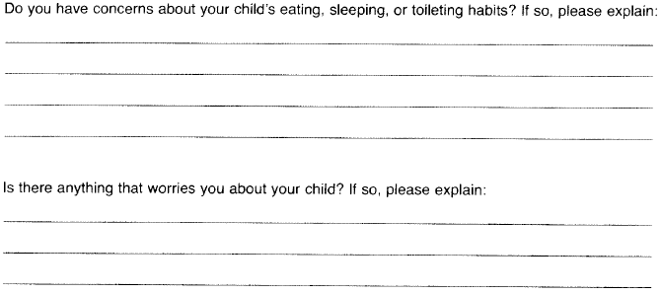
ASQ:SE Administration
Fill out the short answer questions on the last few pages with the parent’s responses.
Example:

Slide 24
ASQ:SE Administration
If parent voices concerns for these questions, ask if they would like to talk with MH/Dis staff or Division Director, as appropriate.
Document conversation in a contact note and on the form. This is like the Concern Bubble for open ended questions, but if you don’t give yourself credit for having the conversation, we have to assume it is a concern.
If parent is concerned and would like a referral, complete an POA and follow the Mental Health & Disabilities referral process.
Do not leave these questions blank! If parent has no concerns to document, write “None”

Slide 25
ASQ:SE Nutrition Concerns
Pay attention to any parent concerns about child’s nutrition or eating habits during ASQ:SE.

Slide 26
ASQ:SE Nutrition Concerns
Example of a nutrition question:
If parent says “Most of the Time” or “Sometimes” for this question, circle or write in the concern (i.e., stuffing foods, vomiting, etc.)
Ask if this is a “Concern” for the parent and mark the “Check if this is a Concern” bubble as appropriate.
If the parent expresses a nutrition concern, let them know we have staff who would be happy to talk to him/her.

Slide 27
ASQ:SE Nutrition Concerns
Example of a nutrition question:
If parent expresses any eating concerns, let him/her know we have staff who can talk with him/her.

Slide 28
Nutrition Referrals for ASQ:SE
If parent expresses a Nutrition Concern on the ASQ:SE:
Complete a POA (Plan of Action) using the POA form.
If parent chooses to Refer to the Division Director, email Irma Guerra, HS Division Director, about the concern (iguerra@spcaa.org)
Then, document in ChildPlus as an Add an Action that referral to Division Director has been made due to ASQ:SE via email.

Slide 29
ASQ:SE Administration- page 8
1
2
Jon Smith
1/19/08
Fill out the top portion on last page with:
Child’s Name, and
Date of Birth
You may leave the other sections at the top of this page blank ONLY IF you filled it out completely on page 2.

Slide 30
ASQ:SE Scoring
Go back through the questionnaire and tally up the points using the following point values:
Z/C next to the checked box = 0
V next to checked box = 5
X next to checked box =10
Checked Concern Column = 5
**NOTE: The codes Z, V, and X do NOT correspond with a certain column. X could be the first column or the third. Pay attention to which letter is next to the marked box on EACH question!

Slide 31
ASQ:SE Scoring
Total the points for each page and document in the bottom right hand corner for the page:
10
5
30

Slide 32
ASQ:SE Scoring (page 8)
Total the points on each page and copy those totals on the appropriate blanks on page 8.

Slide 33
ASQ:SE Scoring (page 8)
Add up all four scores and write the total next to “Child’s total score”.

Slide 34
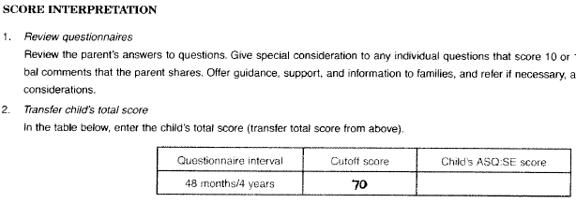
ASQ:SE Scoring (page 8)
Write total score again in the box titled Child’s ASQ:SE Score under “Score Interpretation” #2.
Example: (48 month form, page 8)

Slide 35
ASQ:SE Scoring
Compare the child’s score with the cutoff score listed.
Complete a Mental Health & Disabilities POA for any and all of the following:
Child’s score falls ABOVE the cutoff score for that age (NOTE: If child’s score is EQUAL to the cutoff score, the score is considered passing)
Any of the “Check if this is a Concern” bubbles are marked
Parent expressed concerns on the open-ended questions at the end of the ASQ:SE

Slide 36
In ChildPlus
You will enter the ASQ:SE as Obtain Additional Information if:
Child’s score falls ABOVE the cutoff score for that age (NOTE: If child’s score is EQUAL to the cutoff score, the score is considered passing)
Any of the “Check if this is a Concern” bubbles are marked
OR
Parent expressed concerns on the open-ended questions at the end of the ASQ:SE

Slide 37
Documentation
Remember to document all screenings and POAs in Child Plus before filing the forms in the Child Plus folder for monitors to review.
ALL screenings are confidential and need to be locked up when they are not being used.

Slide 38
You have now completed training for the Ages and Stages Questionnaire: Social-Emotional!
If you have any questions, please feel free to contact:
Matilda Elizondo 762-8815 ext: 1059
Blanca Herron: 762-8815
Billie Carrizales: 762-8815

