Slide 1
Speech and Articulation Screening Test
August 12, 2013
Presenter:
Stacy Morgan,
MH/Disability Manager
Pearson Preschool Language Scale
Fifth Edition

Slide 2
Performance Standard
What is the Performance Standard?

Slide 3
Performance Standard
The need to have a standardized articulation screening in the schools was identified.
§ 1308.6 Assessment of children
Subpart D—Health Services Performance Standards
(b) Screening, the first step in the assessment process, consists of standardized health screening and developmental screening which includes speech, hearing and vision. It is a brief process, which can be repeated, and is never used to determine that a child has a disability. It only indicates that a child may need further evaluation to determine whether the child has a disability. Rescreening must be provided as needed.

Slide 4
Performance Standard
(1) Grantees must provide for developmental, hearing and vision screenings of all Early Head Start and Head Start children within 45 days of the child's entry into the program. This does not preclude starting screening in the spring, before program services begin in the fall.
(2) Grantees must make concerted efforts to reach and include the most in need and hardest to reach in the screening effort, providing assistance but urging parents to complete screening before the start of the program year.

Slide 5
Performance Standard
(3) Developmental screening is a brief check to identify children who need further evaluation to determine whether they may have disabilities. It provides information in three major developmental areas: visual/motor, language and cognition, and gross motor/body awareness for use along with observation data, parent reports and home visit information. When appropriate standardized developmental screening instruments exist, they must be used. The disabilities coordinator must coordinate with the health coordinator and staff who have the responsibility for implementing health screening and with the education staff who have the responsibility for implementing developmental screening.

Slide 6
Why is screening so important?

Slide 7
Screening:
Helps identify children who may need to be referred for further speech evaluation
Opens communication with parents about any other concerns they may have about their child

Slide 8
Purpose of PLS – 5
Screening Test
PLS - 5 screening is comprehensive and based on sound research, yet quick to administer
PLS – 5 screening is designed to identify children who may need to be referred for further speech or language assessment.
It CANNOT be copied!! You MUST use originals!

Slide 9
Purpose of PLS – 5 Screening Test
PLS – 5 Screens for:
Language
Articulation
Fluency
Communication skills
Social/Interpersonal skills
Connected speech
Voice concerns

Slide 10
Purpose of PLS – 5 Screening Test
Can be administered in 5 -10 min
Easy to use and score
Can be administered by teachers, paraprofessionals, and teacher’s aides

Slide 11
The PLS – 5 screening test is:
NOT designed to identify strengths or weaknesses
NOT designed to provide a diagnosis
**Do NOT submit referrals stating that the child “has a disability” or “needs services”.**

Slide 12
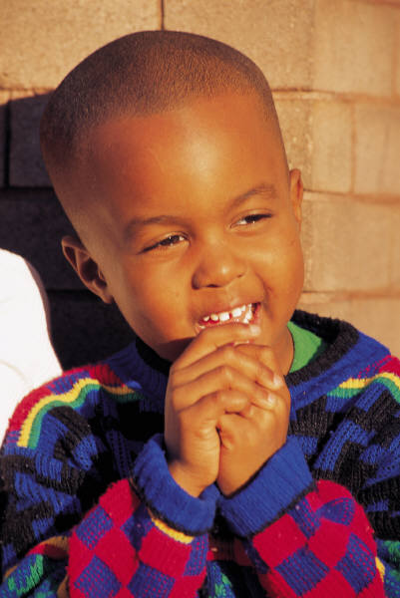
PLS – 5 Administration
What you’ll need:
Manual
Record Form (for age 3, 4, or 5)

Slide 13
PLS – 5
Administration
Seating Arrangements
  Arrange manual such that you and the child can both see the pictures and you can see the questions.
Table
Manual
Examiner
Child

Slide 14
PLS-5 Administration
Complete the screening in BLUE INK ONLY!! NO PENCILS!
Scratch paper may be used if necessary for determining chronological age, but information should then be transferred to Screening Form in blue ink.
Everything must be filled out. Do not leave any blanks.

Slide 15
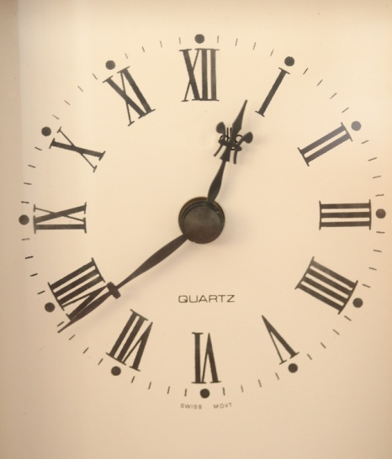
PLS – 5 Administration Time
- Not a timed test
- Allow adequate time for child to respond to test items (approx 10-15 seconds)
Be careful not to pressure the child to respond if he is thinking
Give child “Think Time”

Slide 16
PLS-5 Administration
Before you begin, enter the child’s information at the top of the form:
Name- child’s name
Sex- check F for female and M for male
Address- address of your center/school
Screening Site- name of your center
Caregiver/Teacher- teacher’s name
Examiner- your name
Remember: Fill out everything. Do not leave anything blank.

Slide 17
PLS-5 Administration
Enter the Date Tested and child’s Date of Birth in the box in the upper right hand corner.
Make sure you do this BEFORE screening begins to ensure you are using the right form.
 | Year | Month | Day
Date Tested | 2013 | 09 | 15
Date of Birth | 2009 | 05 | 30
Age

Slide 18
PLS-5 Administration
Calculating chronological age:
Subtract the child’s birth date from the test date, starting with the “Day” column (far right):
If testing day is smaller than DOB day, you have to “borrow” from the testing month:
  Subtract 1 month from the testing month and then,
  Add 30 days to the testing day. (Always add 30 days, regardless of what month it is.)
  Continue subtracting DOB day from testing day.
 | Year | Month | Day
Date Tested | Testing Year | Testing Month | Testing Day
Date of Birth | DOB Year | DOB Month | DOB Day
Age

Slide 19
PLS-5 Administration
Example
Using the following information:
Date Tested: September 15, 2012
Date of Birth: May 30, 2008
 | Year | Month | Day
Date Tested | 2013 | 09⁻¹⁼⁸ | 15 ⁺³⁰⁼ ⁴⁵
Date of Birth | 2009 | 05 | -30
Age |  |  | 15

Slide 20
Next, subtract the DOB month from the testing month.
If testing month is smaller than DOB month, you have to “borrow” from the testing year:
  Subtract 1 year from the testing year and then,
  Add 12 months to the testing month.
  Continue subtracting DOB month from testing month.
Finally, subtract the DOB Year from the testing year.
 | Year | Month | Day
Date Tested | 2013 | 09⁻¹⁼⁸ | 15 ⁺³⁰⁼ ⁴⁵
Date of Birth | 2009 | -05 | -30
Age | 4 | 3 | 15

Slide 21
Let’s Practice!
What is the chronological age for the child below?
 | Year | Month | Day
Date Tested | 2013 | 08 | 05
Date of Birth | 2008 | 12 | 03
Age

Slide 22
Let’s Practice!
4 years, 8 months, and 2 days
 | Year | Month | Day
Date Tested | 2013 ⁻¹⁼¹² | 08 ⁺¹²⁼²⁰ | 05
Date of Birth | 2008 | 12 | 03
Age | 04 | 08 | 02

Slide 23
Let’s Practice!
What is the chronological age for the child below?
 | Year | Month | Day
Date Tested | 2013 | 09 | 13
Date of Birth | 2009 | 11 | 28
Age

Slide 24
Let’s Practice!
3 years, 9 months, and 15 days
 | Year | Month | Day
Date Tested | 2013 ⁻¹⁼¹² | 8+12= 20 09 ⁻¹⁼⁸ | 13 ⁺³⁰⁼⁴³
Date of Birth | 2009 | 11 | 28
Age | 3 | 9 | 15

Slide 25
PLS – 5 Administration
Complete sections in order:
  Language Section
  Articulation Section
  Connected Speech Section
  Social / Interpersonal Skills Section
  Fluency Section
  Voice Section

Slide 26
PLS-5 Administration
The Language section looks at how well a child can both understand and express various types of language. Can s/he:
  Provide names for pictures?
  Understand negatives in a sentence (“not”, etc)?
  Follow simple directions?

Slide 27
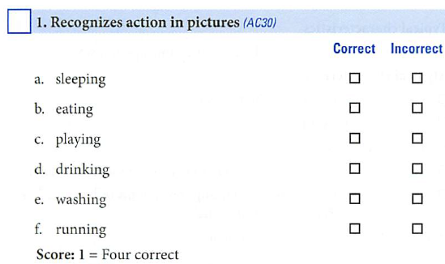
PLS-5 Administration
As you go through each section, make sure you are paying attention to the “SCORE” note underneath EACH question to determine what number to put in the box next to the item number! The formula is different for each item number and each age. Example: (3 y/o form, #1 of Language Section)

Slide 28
PLS-5 Administration
Articulation section
Looks at whether a child can say certain developmentally appropriate sounds
Pay attention to the way the child says the identified letters from each word.
NOTE: Some words have more than one letter for the child to be scored on.
If the child says the letter sound to the right of the word correctly, mark “Correct” regardless of how s/he said the rest of the word.

Slide 29
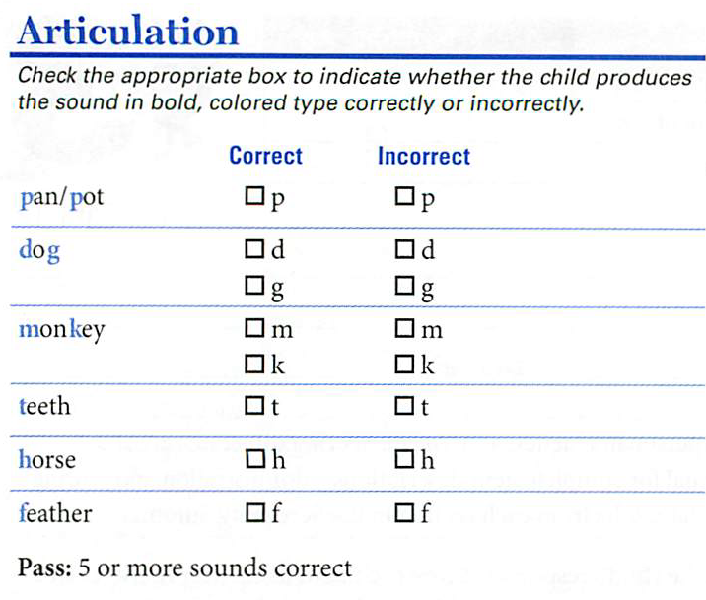
PLS-5 Administration
Articulation (Ex: 3 y/o form)
  You will point to pictures and ask the child to say the name of the object/animal.
These are the sounds you will need to pay attention to.

Slide 30
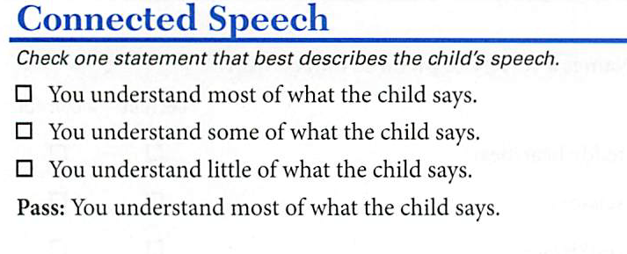
PLS-5 Administration
Connected Speech
This section is just asking how well you can understand what the child says and if you can make out most of his/her words, stories, etc.

Slide 31
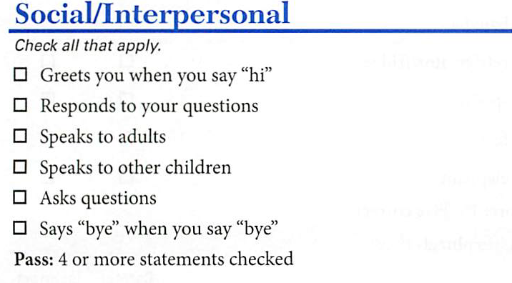
PLS-5 Administration
Social/Interpersonal
Looks at how well the child verbally interacts with others.

Slide 32
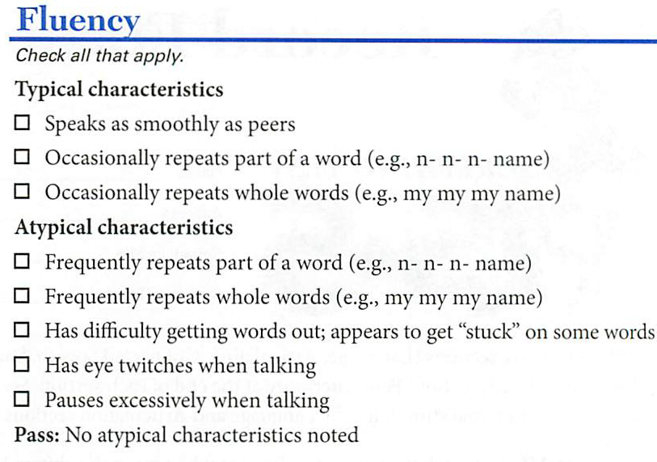
PLS-5 Administration
Fluency
How well the child’s speech flows
Is child’s speech disrupted by other sounds, prolonged pauses, etc.

Slide 33
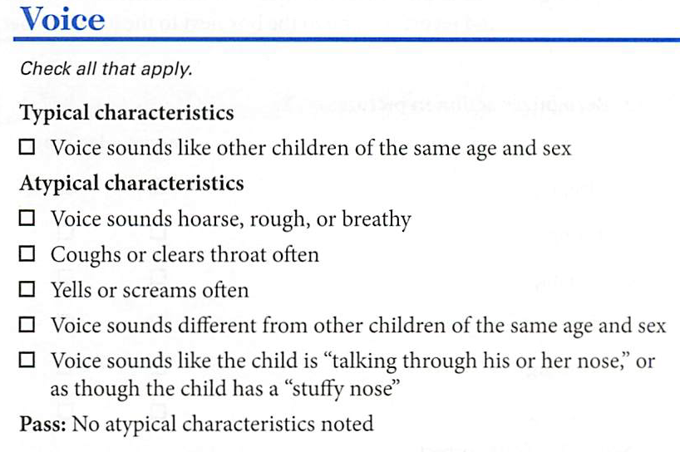
PLS-5 Administration
Voice
Pitch, resonance, and loudness of child’s speech

Slide 34
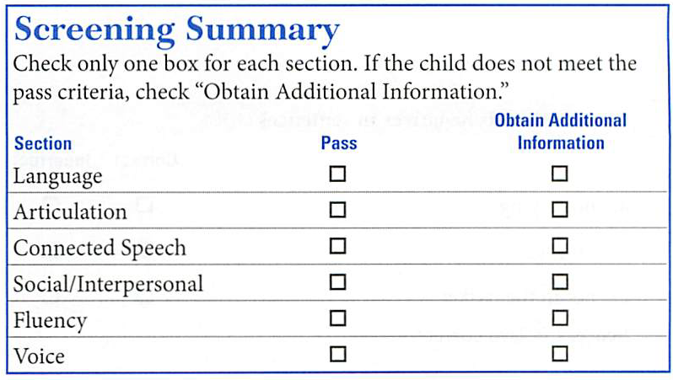
PLS-5 Administration
Follow the directions at the end of each section (i.e., language, articulation, etc.) regarding the “Pass” scores.
Mark “Pass” or “Obtain additional information” under the screening summary on the back of the form.
Check one box for each section! Do not leave any blank.

Slide 35
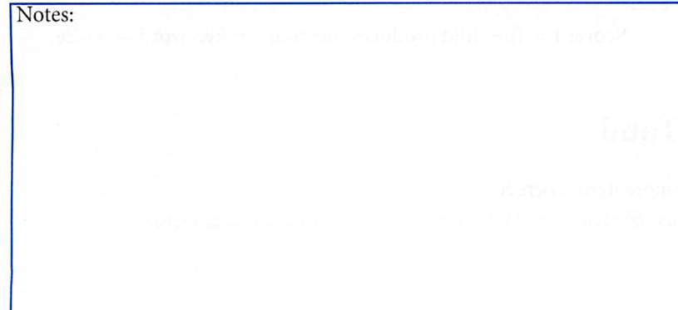
PLS-5 Screening
Making Recommendations:
When making recommendations for additional assessment, it is important to include observations about the child’s behavior and participation during the administration of the screening. Document these in the Notes section:
Notes:
EX: may be tired from nap and not actively participating as a result

Slide 36
PLS-5 Screening- Spanish
There are Spanish forms and Spanish manuals available to every grantee.
The PLS-5 Spanish version is completed just like the English PLS-5- it has the same sections, the same format, and you will use a manual with pictures.
To screen a child in Spanish, you must be fluent in Spanish.

Slide 37
PLS-5 Screening- Spanish
Any child who speaks primarily Spanish should be screened in Spanish.
  Check with the parents if you are unsure if you should use Spanish or English form.
  Screening in the correct language helps prevent mis-identification. Children speaking different languages develop different sounds first. The Spanish screening is research based to focus on the sounds a Spanish speaking child at that age should have mastered.

Slide 38
Keep In Mind…
Young children may perform poorly in a structured test situation because it is new to them.
Poor performance may be due to the child’s lack of attention, distractibility, or not following directions.

Slide 39
What to do next
If the child did not pass the screening, complete a Mental Health/Disabilities Plan of Action (POA) with the parent. Decide to:
  rescreen within 2 weeks
  make an immediate referral to Mental Health and Disability staff
  parent may decline rescreening and referral (Complete Declined Services Form)
  or child is already in services

Slide 40
Record Keeping
Remember that PLS-5 screening results need to be entered into Child Plus before they are placed in the Child Plus folder for MH/D to review.
Screening results are considered CONFIDENTIAL. All screening forms with children’s information on them are to be locked up when not being used.

Slide 41

HIP HIP HOORAY!
You are now trained to administer the PLS-5 Screening Test!!!
Give your brain a KISS

Slide 42
Thank you!
Stacy Morgan
smorgan@spcaa.org
Blanca Herron
bherron@spcaa.org
Leigh Wells
lwells@spcaa.org
(806) 762-8815

