Slide 1
Supporting Children with
Special Needs
Jennifer Crookham
Mental Health/Disabilities Manager
SPCAA Head Start/Early Head Start

Slide 2

What is an IEP?
A written plan
Includes goals
“Roadmap”
Notes:
What does IEP stand for?
Written plan for meeting child’s individual needs
Goals for child to work on throughout upcoming year
Serves as a Roadmap to guide teaching

Slide 3
Knowing About the IEP
Helps you know what the child can do and what they are working on
Helps you support the child where they are at while challenging him/her to do more
Helps prepare you to provide input at the annual ARD meeting
Notes:
What is an IEP?
Why is it important for teachers to know what it says? –A lot of the time, teacher feedback is used to determine if child met annual or short term goals

Slide 4
Knowing about the IEP
“Clearly, the IEP is a very important document for children with disabilities and for those who are involved in educating them. Done correctly, the IEP should improve teaching, learning and results.“
–U.S. Dept of Education
http://www2.ed.gov/parents/needs/speced/iepguide/index.html#closer
Notes:
How can it improve teaching if the teacher doesn’t know what it says?

Slide 5
IEP Goals: Long Term
Determine how much you think the child will develop and/or increase skills in this area in a year’s time.
Examples:
  John will increase his receptive/expressive language and articulation skills targeting phonology, semantics, morphology, and syntax to 70% accuracy as measured by pre and post therapy data.
  Suzie will demonstrate measurable progress toward the use of developmentally appropriate vocabulary, word relationships, and/or word retrieval skills as measured by the mastery of a minimum of 70% of the annual IEP objectives.
Notes:
You can use these goals as guidance in how to support the child in your class.

Slide 6
IEP Goals: Short Term
Breaks the annual goal into smaller pieces.
Examples:
  Sarah will button 5 buttons on her sweater by herself when asked 4/5 times.
  Mark will continue to label items (nouns) and actions (verbs) during a story or activity 8/10x’s for 6 weeks as measured by observations.

Slide 7
IEP Goals: Short Term
Short term goals include:
  WHO (child)
  Will DO What (will stack 4 one inch blocks)
  With What Assistance (when shown how, etc)
  How Well (4/5 times)

Slide 8
Using the IEP in the Classroom
Head Start calls it individualizing
By definition, children with disabilities need extra support in the classroom
Worked into the everyday activities and routine
Notes:
Who can tell me about the individualizing you do for all kids in your class?
Need extra support because to be diagnosed by the school district, their disability must significantly affect their ability to perform, learn, and achieve in the classroom.

Slide 9
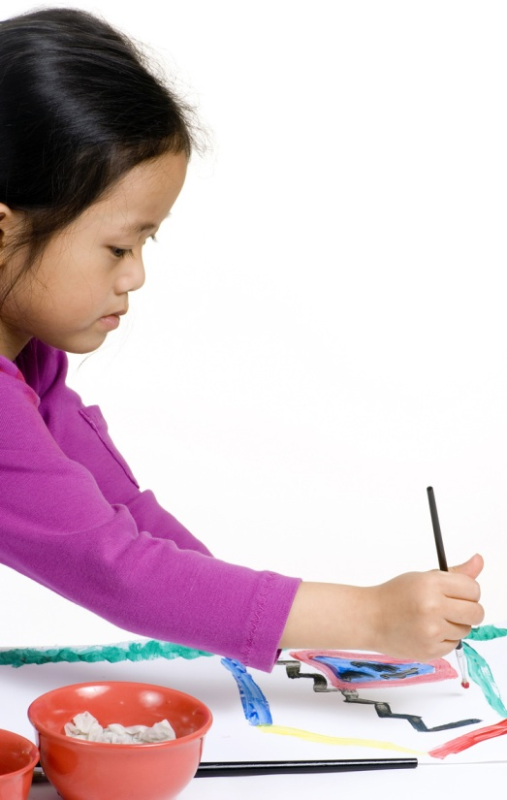
Develop a Plan for Individualizing
Indentify the skills
Select the activities
Teach skills throughout
the day
Work it into what you’re
already doing

Slide 10
Daily Routine
Circle time
Small group time
Outdoor play/ gross motor
Learning centers
Music and movement
Story time
Notes:
Pick the time when you will have the greatest chance of reaching this kid and supporting him/her
If distracted during circle time, depending on what you are working on, this might not be the best time for individualization to occur.
Outdoor or music times are great for gross motor activities
Centers- encourage to go to center or activity that will help develop certain skills
Story time- can work on cognitive or comprehension skills- ask to remember or repeat something from the story

Slide 11
How to Individualize
Same activity and materials as other kids but different objectives/skills
Ex: one child sorts, while another reaches and grasps

Slide 12
Individualization Examples
Speech Impairments:
  ANY language activity can be used to individualize
  Can work speech individualizations into just about any activity
  BE familiar with the IEP
    Working on receptive or expressive?
    What specific sounds is the child working on?
Notes:
Receptive goal might be to respond to 2 step directions, so you can work on that
Might be working on specific sounds- you can call on that child to repeat a word using that sound- give opportunities to practice
Might be working on specific parts of words (beginning or end)- again, ask to say a specific word or phrase and emphasize the part child is working on when you say it
Could be as simple as making it a point during some activity to make child ask for what he or she wants instead of pointing or gesturing

Slide 13
Individualization Examples
Autism
  Using picture rule cards
  Using brief directions (2 words)
  Helping child work on social skills- you can role play with him about how to ask someone to play with him or how to tell someone he wants to play alone
Notes:
Again, you have to be familiar with the IEP to know what the struggles are
Could be as simple as being mindful about having child say please/thank you

Slide 14
Individualizing Examples
Motor Related Disabilities
  Fine Motor examples
    Drawing shapes, objects, etc.
    Using buttons, zippers, lacing, etc.
  Gross Motor examples
    Skipping, hopping, jumping, running, reaching, stretching

Slide 15
Individualizing
Who?
  Any child with at least 1 IEP will have 1 individualization per IEP
  Any child in RTI will have at least 1 individualization
How Often?
  Every week
Notes:
This disability individualization is in addition to the individualization every Head Start child receives.

Slide 16
Documenting
Should be documented on the lesson plan
Next to activity on lesson plan
  Use an asterisk (*) and your code for the child
Notes:
Throughout lesson plan to indicate specific activities in which individualization will occur for a child with a disability
Using the code helps maintain confidentiality- it could be a number, symbol, shape, etc.
The * signifies that this is the individualization for child’s disability

Slide 17
Questions?
Jennifer Crookham
MH/ Disabilities Manager
Blanca Herron and Leigh Wells
MH/ Disabilities Assistants
806-762-8815

